Slide 1

Named Entity Recognition
Tyler Spangler, Aaron Giddings, Max Thompson
Notes:
Sources:
https://towardsdatascience.com/named-entity-recognition-with-nltk-and-spacy-8c4a7d88e7da
https://en.wikipedia.org/wiki/Named-entity_recognition
https://medium.com/explore-artificial-intelligence/introduction-to-named-entity-recognition-eda8c97c2db1

Slide 2
What Is Named Entity Recognition?
- An information extraction technique that seeks to locate and classify named entities in text into pre-defined categories such person names, organizations, locations, time expressions, quantities, monetary values, percentages, etc.
Example:
Jim bought 300 shares of Boeing in 2006.
[Jim]_{Person} bought 300 shares of [Boeing]_{Organization} in [2006]_{Time}.

Slide 3
What is a “named entity?”
Named entity recognition is NOT “part of speech tagging”
A named entity is a specific real-world object such as persons, locations, organizations, products, etc.
Exclude pronouns (such as “it”)
Closely related to rigid designators (Kripke)
Fluid definition
Temporal and numerical expressions often included

Slide 4
Two Steps
Detection of entities (ex. Bob, Chevy, 2004)
Classification of entities (ex. Name, Company, Time)

Slide 5
Detection of Entities
Token = word, time, etc … basically any string of characters without spaces
Single word/token entities
(ex. Ford or America)
Multiple word/token entities
(ex. Ford Motor Company, Henry Ford, or Bank of America)

Slide 6
Detection of Entities: Common Problems
Fewer tokens than desired (missing “M.D.” in “John Smith, M.D.”)
More tokens than desired (including “The” in “The University of MD”)
Splitting entities incorrectly (treating “Smith, Jones Robinson” as 2 vs. 3 entities)
Other (identifying “James Madison” as a personal name when it is part of "James Madison University”)

Slide 7
Measures of Error
Precision
Correct classification & correct entity
Recall
Proper detection
F1 score
Harmonic mean of precision and recall

Slide 8
Classification of Entities
NER systems have been created using:
Grammar-based techniques
Better precision, worse recall
Longer to make
Statistical models & machine learning
Worse precision, better recall
Faster to make
Take large amounts of data
NER systems are often domain specific

Slide 9
Overview of Current NER Methods
- Sequence Labeling
Standard algorithm is a word-by-word sequence labeling task where tags capture the boundary and type
IOB tagging – tags the Inside of each entity type, the Outside of each entity type, and the Beginning of each entity type
Number of tags is then 2n + 1
Ex: [Jim Smith]_{Person} bought 300 shares of [Boeing Company]_{Organization} in [2006]_{Time}.
Often just IO tagging is enough to capture the entities with only n + 1, but it may lose
some information and not be able to distinguish between two entities of the same type.
Word | IOB Label
Jim | B-Person
Smith | I-Person
300 | O
Shares | O
Of | O
Boeing | B-Org
Company | I-Org
2006 | I-Org
Notes:
Source: Speech and Language Processing: An introduction to Natural Language Processing, Computational Linguistics, and Speech Recognition by Daniel Jurafsky and James H. Martin

Slide 10
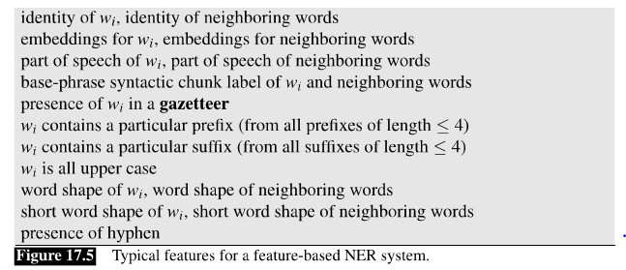
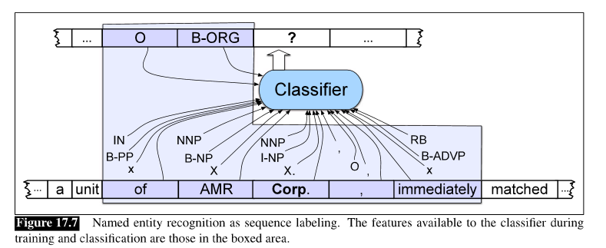
Feature Based Algorithm
- Extracts features and trains a MEMM or CRF sequence model to classify the type of NE
Word shape is especially important as it represents the abstract letter patterns of the word – ex: Jim Smith → Xxx Xxxxx
Gazetteer is a list of place names and a name list is a list of first names and surnames published by the Census Bureau. These are hard to create and maintain but can be useful is available.
Notes:
Source: Speech and Language Processing: An introduction to Natural Language Processing, Computational Linguistics, and Speech Recognition by Daniel Jurafsky and James H. Martin

Slide 11
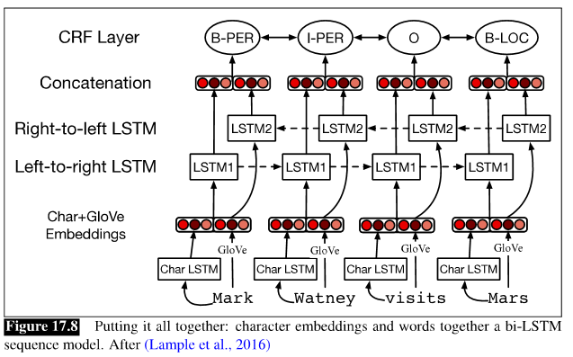
Neural Based Algorithm
The standard NER neural algorithm approach is using a bi-LSTM with a CRF layer to decode the output of the bi-LSTM
In the algorithm, word and character embeddings of the input word are computed for the input word and passed through a left-to-right and right-to-left LSTM after which the two outputs are combined and can be pushed to an output layer where the probability distribution across all NER tags is computed and the tag with the highest probability is assigned to the input word
This method does not all the strict constraints of neighboring words that NER requires, so a CRF layer is added after the bi-LSTM and the Viterbi decoding algorithm is used to assign the NER tag.
Notes:
Source: Speech and Language Processing: An introduction to Natural Language Processing, Computational Linguistics, and Speech Recognition by Daniel Jurafsky and James H. Martin
https://medium.com/@raghavaggarwal0089/bi-lstm-bc3d68da8bd0
https://medium.com/ml2vec/overview-of-conditional-random-fields-68a2a20fa541

Slide 12
Ruled Based Algorithm
- This approach is a mix of grammar based and machine learning approaches where the approach is to make several rule-based passes through a text and allow the pass to influence the next pass. These passes have high precision and low recall
- Steps:
1. Use high-precision rules to tag ambiguous entities
2. Search for substring matches of previously detected names
3. Consult application-specific name lists to identify likely name entity mentions from the given domain
4. Apply probabilistic sequence labeling techniques that make use of previous tags as additional features
Notes:
Source: Speech and Language Processing: An introduction to Natural Language Processing, Computational Linguistics, and Speech Recognition by Daniel Jurafsky and James H. Martin

Slide 13
Uses of NER
- Some common uses of NER include:
Classifying categories for newspapers providers
Using NER can enable the article to placed in the appropriate section or hierarchy of a newspaper
Search Algorithms
This could be applied for the phone user data set that we are using. Consider that Samsung is only interested in viewing their reviews (and the data did not separate it out already), they could run NER on all the reviews and determine which reviews mentioned them or one of their products without reading each review
Content Recommendations
Newspaper websites can use NER to recommend other articles to user. For example, if you read an article about Trump (who is a named entity) the website can then recommend articles with this named entity.
Sentiment for Named Entities
NER can allow sentiment to be attributed to named entities such as products or companies. Using our phone user data, if company is only looking for negative reviews, after running NER they can run sentiment analysis on their reviews and identify the amount of negatives vs. positive reviews
Notes:
Sources:
towardsdatascience.com/named-entity-recognition-applications-and-use-cases-acdbf57d595e
Youtube.com/watch?v=ARsDDlffoMK&list=PLQiyVNMpDLKnZTBTYOISI9mi9wAErFtFM&index=44

